Slide 1

Previously On...
Digital Inputs

Slide 2
Previously On...
Digital Inputs
if() statements

Slide 3
Boolean Operators
<Boolean> | True if:
(a) | a is true, HIGH or does not equal zero
(!a) | a is false, LOW or equals zero
(a) == (b) | a is equal to b
(a) != (b) | a is not equal to b
(a) > (b) | a is greater than b
(a) >= (b) | a is greater than or equal to b
(a) < (b) | a is less than b
(a) <= (b) | a is less than or equal to b
(a) && (b) | both a is true AND b is true
(a) || (b) | either a is true OR b is true

Slide 4
Previously On...
Digital Inputs
if() statements

Slide 5
Previously On...
Digital Inputs
if() statements
Pull-up resistors

Slide 6


Seriously, the one thing to take away
Notes:
This is why there’s a diversity problem in Engineering

Slide 7

analogRead()
Project #5 – Night Light
How Dark Is Too Dark?
Psuedo-code – how should this work?
LED turns on
TOO DARK!
Check How Dark It Is
How Dark Is It?
Rinse & Repeat
IT’S FINE
LED turns off

Slide 8
Project #4 - Night Light Inputs and Outputs
LED turns on
TOO DARK!
Check How Dark It Is
How Dark Is It?
Rinse & Repeat
IT’S FINE
LED turns off
Inputs | Outputs
Photoresistor | LED

Slide 9
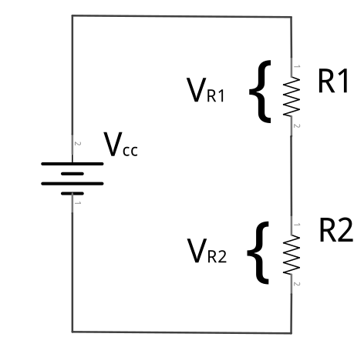
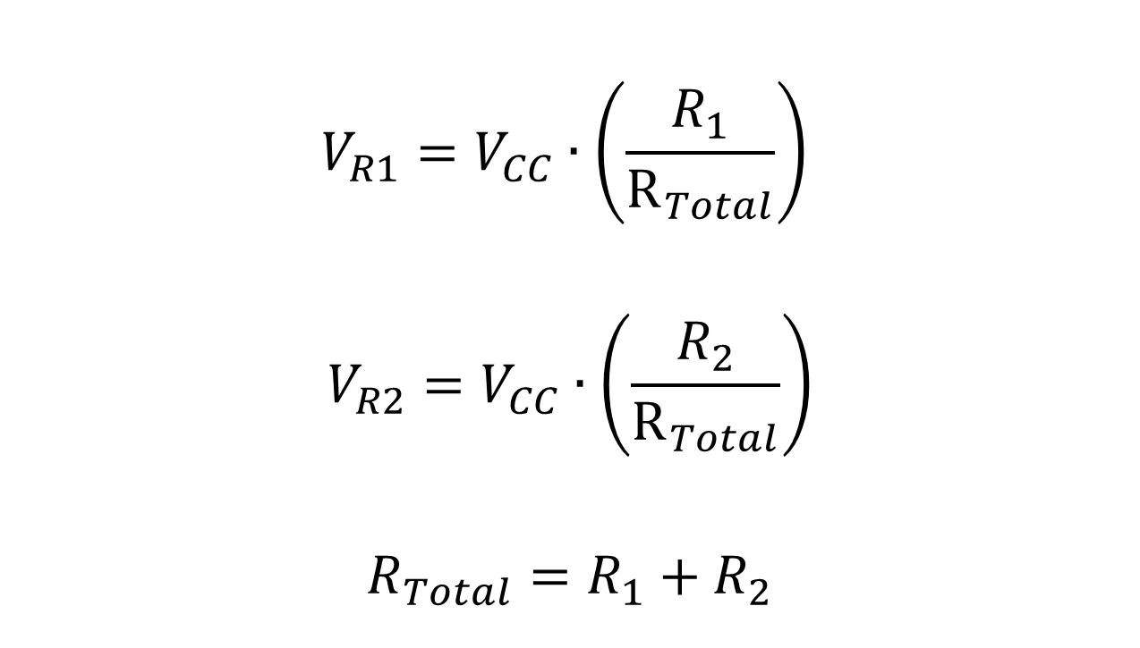
The Voltage Divider

Slide 10

The Voltage Divider

Slide 11

The Voltage Divider
“From each according to their ability, to each according to their need.”

Slide 12

The Voltage Divider
How many carrots does the fairy have left at this point?

Slide 13

The Voltage Divider
How many carrots does the fairy have left at this point?

Slide 14

The Voltage Divider
How many carrots does the fairy have left at this point?

Slide 15

The Voltage Divider
How many carrots does the fairy have left at this point?

Slide 16

The Voltage Divider
How many carrots does the fairy have left at this point?

Slide 17
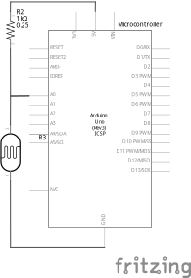
The Switch-Over

Slide 18
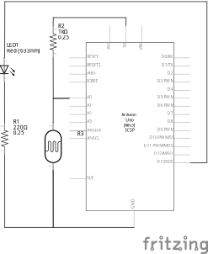
Project #4 – Night Light Schematic

Slide 19
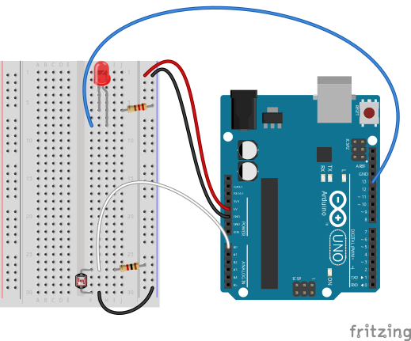
Project #4 – Night Light Wiring Diagram

Slide 20

Project #4 – Night Light
int sensor_val = analogRead(pin);
pin – refers to the analog input pin (limited to pins A0, A1, A2, A3, A4 and A5)
Arduino uses a 10-bit analog-to-digital converter (ADC):
This means that sensor_val is always a number between 0 and 1023
Minimum Carrots → 0
Maximum Carrots → 1023

Slide 21
Determining Analog Values
But the top bunny is always going to get some carrots, so we can’t really get to 1023
And we can’t really make our bottom bunny so small that it gets 0 carrots
So how do we determine the minimum and maximum numbers for our circuit?
Do math

Slide 22
Determining Analog Values
But the top bunny is always going to get some carrots, so we can’t really get to 1023
And we can’t really make our bottom bunny so small that it gets 0 carrots
So how do we determine the minimum and maximum numbers for our circuit?
Do math
Ask the microcontroller

Slide 23
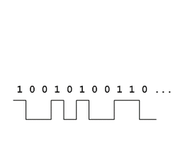


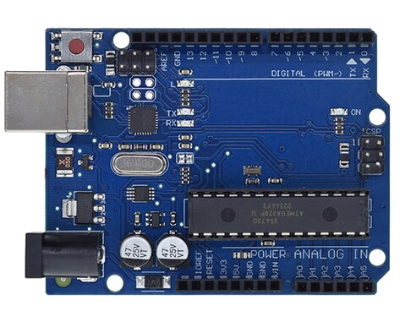
Using Serial Communication
Method used to transfer data between two devices.
Data passes between the computer and Arduino through the Universal Serial Bus (USB!) cable. Data is transmitted as zeros (‘0’) and ones (‘1’) sequentially.
Arduino dedicates Digital I/O pin # 0 to receiving and Digital I/O pin #1 to transmit.
Notes:
Serial is the same for novels, soldiers, murders, killers, communication
For this reason, we typically do not use Digital I/O 0 or 1 for anything in our designs.

Slide 24
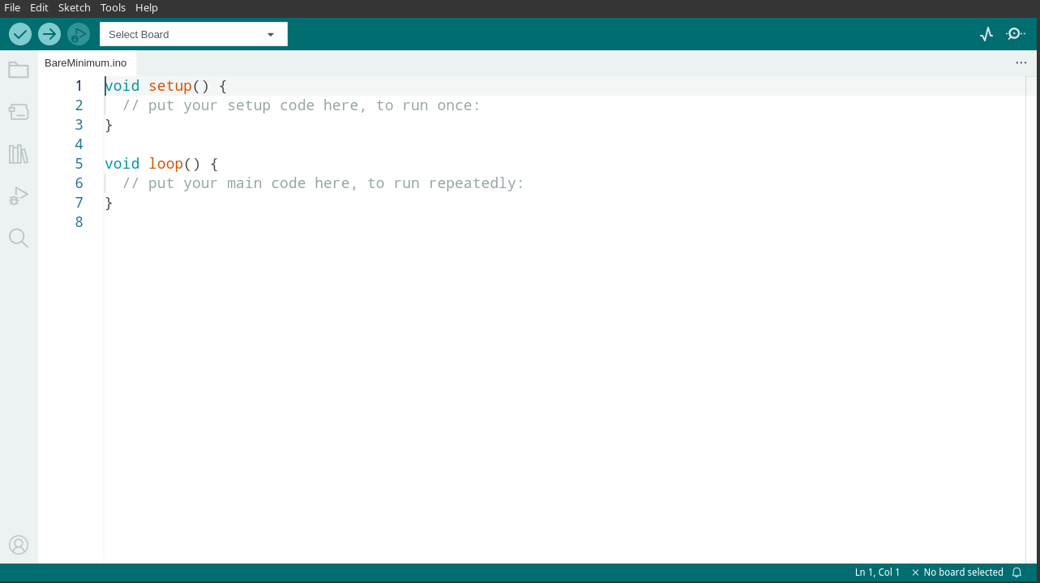
Displaying the Serial Monitor

Slide 25
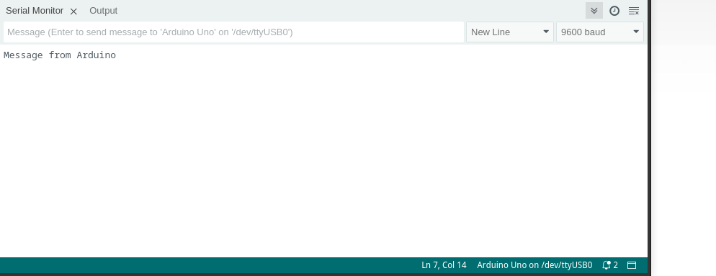
A Tour of the Serial Monitor

Slide 26
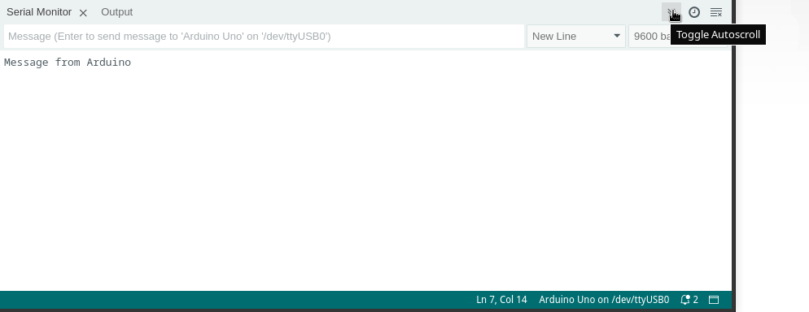
A Tour of the Serial Monitor

Slide 27
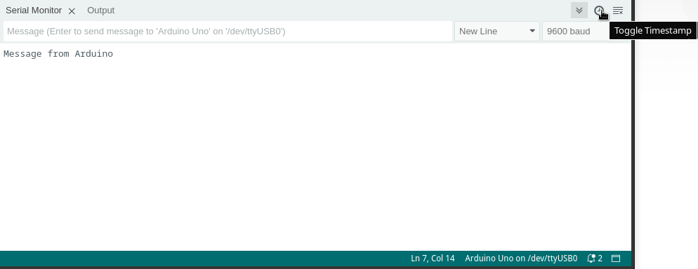
A Tour of the Serial Monitor

Slide 28
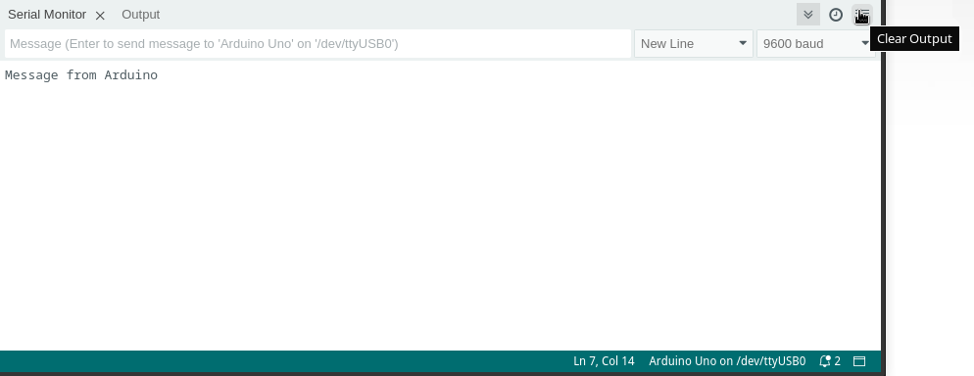
A Tour of the Serial Monitor

Slide 29
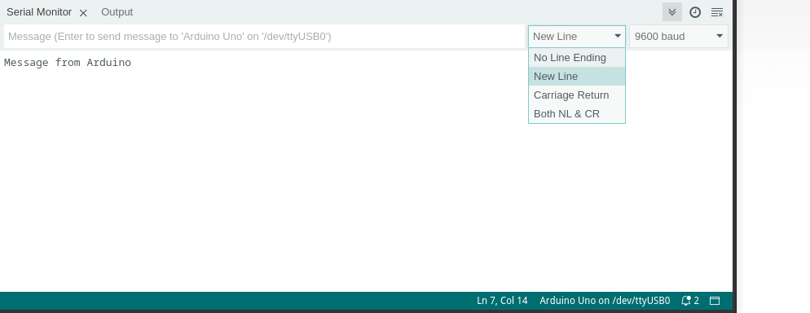
A Tour of the Serial Monitor

Slide 30
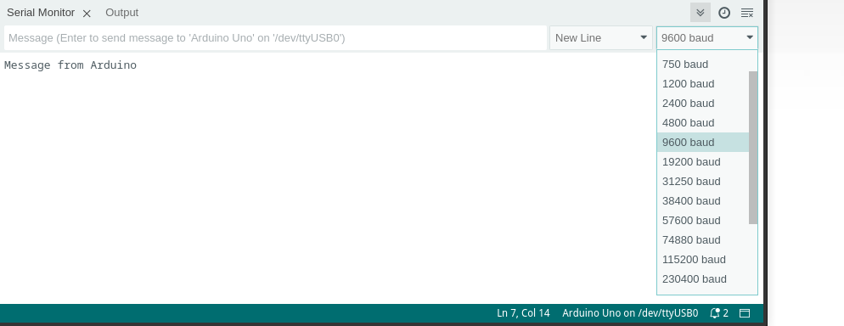
A Tour of the Serial Monitor

Slide 31
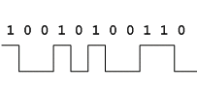
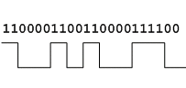
Baud Rate
How do we know how many 0’s and 1’s there are?
We tell how the computer and microcontroller how long a signal has to be high or low to count as a 1 or a 0 by setting the baud rate
For our purposes it doesn’t really matter what the baud rate is, it’s just important that the microcontroller and computer agree!

Slide 32
Serial Commands
Serial.begin(baud_rate);
ex: Serial.begin(9600);
Serial.print(“Text”);
Serial.print(variable);
Serial.println(“Text”);
Serial.println(variable);

Slide 33
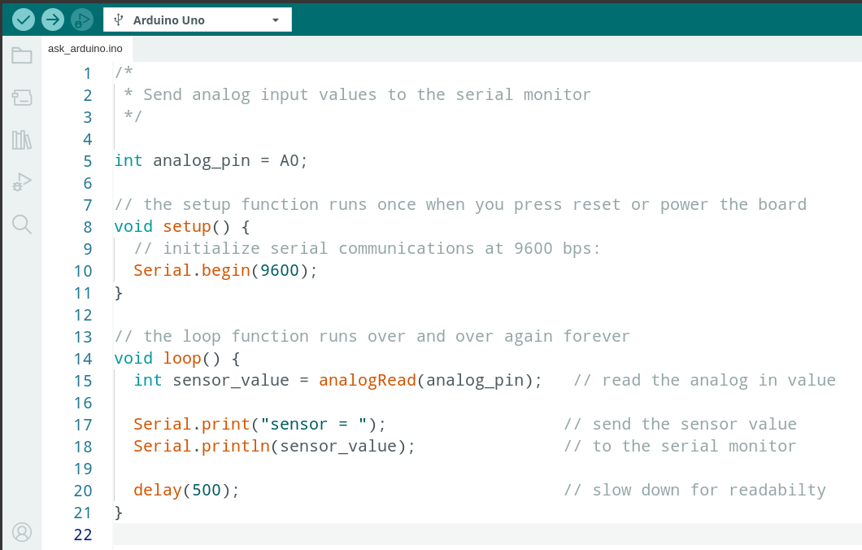
Ask Arduino - Code Review

Slide 34
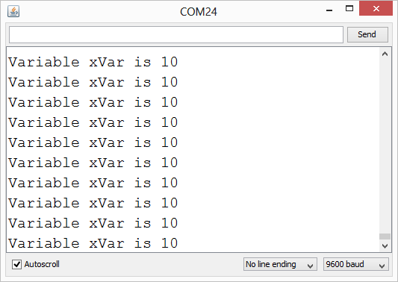
Serial Communication: Serial Debugging
void loop()
{
int xVar = 10;
Serial.print ( “Variable xVar is “ ) ;
Serial.println ( xVar ) ;
}

Slide 35
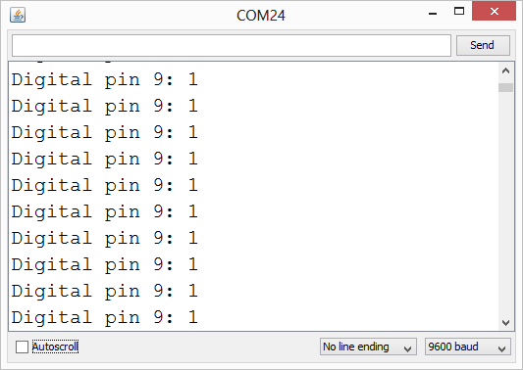
Serial Communication: Serial Troubleshooting
void loop ( )
{
Serial.print (“Digital pin 9: “);
Serial.println (digitalRead(9));
}

Slide 36
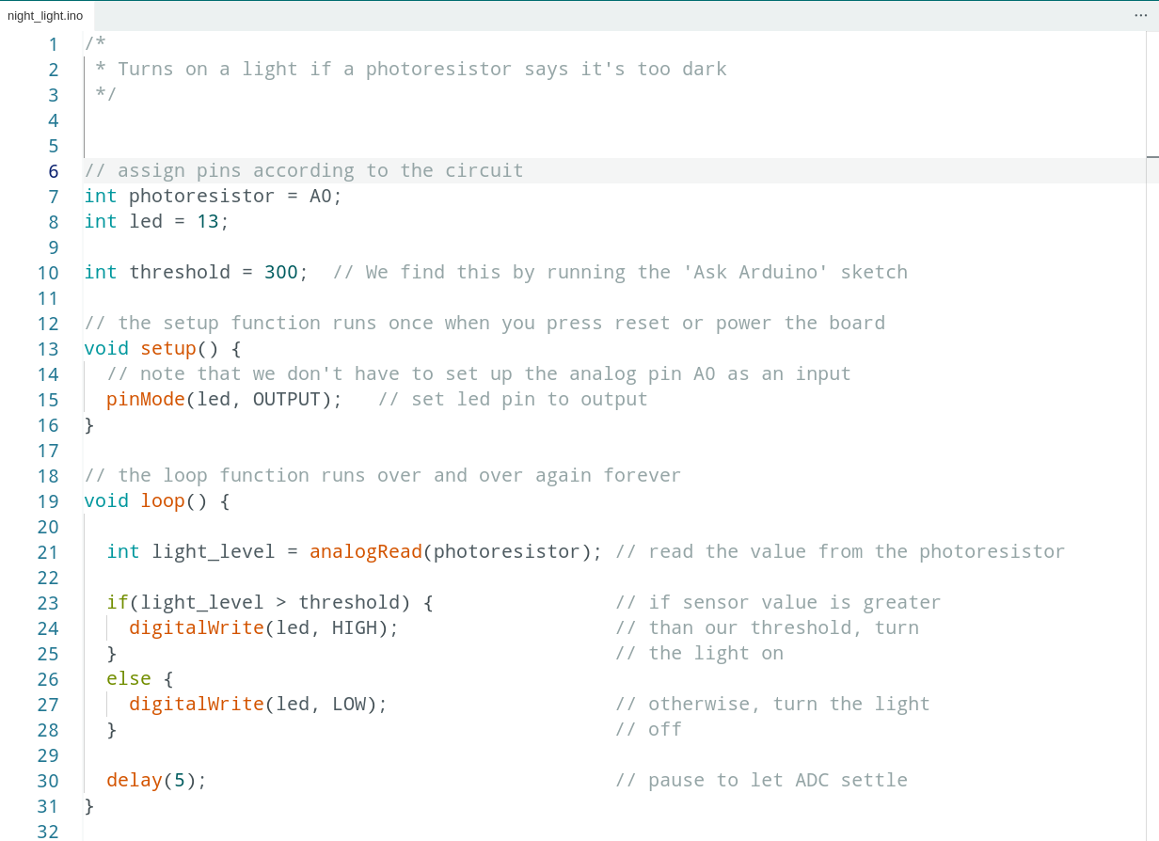
Night Light - Code Review

Slide 37
Analog Sensors
Examples:
Sensors | Variables
Photoresistor | light_level
Microphone | sound_volume
Temp Sensor | temp
Flex Sensor | bend
Accelerometer | tilt, acceleration

Slide 38
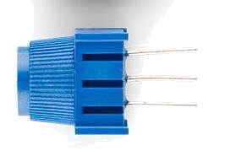
Trimpot (Potentiometer) Variable Resistor
fixed
end
wiper
fixed
end

Slide 39

Trimpot (Potentiometer) Variable Resistor

Slide 40
Trimpot (Potentiometer) What does it mean?
Since we’re controlling the size of both bunnies:
We can make either bunny so small it gets zero carrots
We get the full range of 0-1023!
This makes potentiometers excellent controllers for physical computing “settings”
Can we think of any examples?

Slide 41
Trimpot (Potentiometer) What does it mean?
Since we’re controlling the size of both bunnies:
We can make either bunny so small it gets zero carrots
We get the full range of 0-1023!
This makes potentiometers excellent controllers for physical computing “settings”
Can we think of any examples?
But what if the setting we want to control has less (or more) than 1023 values? Or if we want it not to start at 0?

Slide 42
Trimpot (Potentiometer) What does it mean?
Since we’re controlling the size of both bunnies:
We can make either bunny so small it gets zero carrots
We get the full range of 0-1023!
This makes potentiometers excellent controllers for physical computing “settings”
Can we think of any examples?
But what if the setting we want to control has less (or more) than 1023 values? Or if we want it not to start at 0?
Do math

Slide 43
Trimpot (Potentiometer) What does it mean?
Since we’re controlling the size of both bunnies:
We can make either bunny so small it gets zero carrots
We get the full range of 0-1023!
This makes potentiometers excellent controllers for physical computing “settings”
Can we think of any examples?
But what if the setting we want to control has less (or more) than 1023 values? Or if we want it not to start at 0?
Do math
Get the microcontroller to do it for us

Slide 44
Map Command
int new_var = map(old_var, old_low, old_high, new_low, new_high);
ex: offset_val = map(val, 0, 100, -50, 50);
ex: reverse_val = map(val, 1, 100, 100, 1);
ex: write_val = map(read_val, 0, 1023, 0, 255);

Slide 45
Project #5 – Real Time Color Mixer
Tying it all together...
Psuedo-code – how should this work?
Change to green
Light green LED
RED
Button A Pressed?
Pressed Before?
Current LED?
Change to blue
Light yellow LED
YES
NO
GREEN
BLUE
Change to red
Light red LED
Write a scaled trimpot value to red pin of RGB LED
RED
Button B Pressed?
Read trimpot
Current LED?
Write a scaled trimpot value to green pin of RGB LED
YES
GREEN
BLUE
Write a scaled trimpot value to blue pin of RGB LED

Slide 46
Project #5 – Inputs and Outputs
Inputs | Outputs
a “Select” Button | Red Indicator
an “Adjust” Button | Green Indicator
Trimpot | Blue Indicator
 | RGB LED

Slide 47
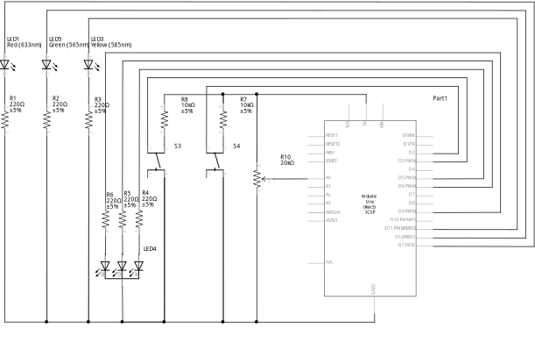
Project #5 – Real Time Color Mixer Schematic

Slide 48
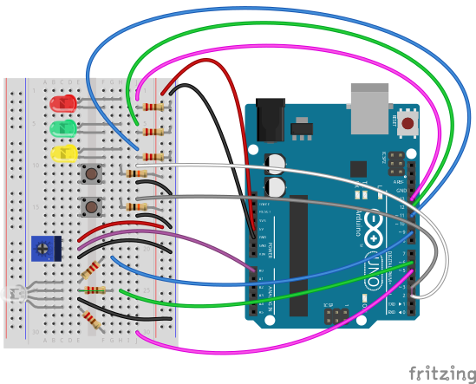
Project #5 – Real Time Color Mixer Wiring Diagram

Slide 49
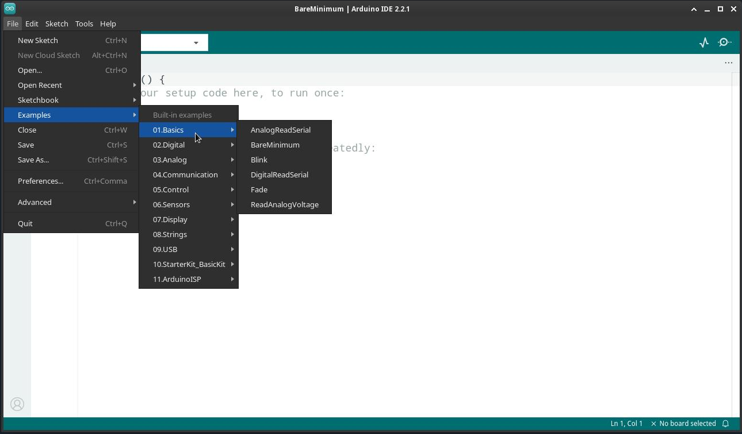
Where To Go From Here:

Slide 50




Special Thanks:
www.sparkfun.com
6175 Longbow Drive, Suite 200
Boulder, Colorado 80301

